Slide 1
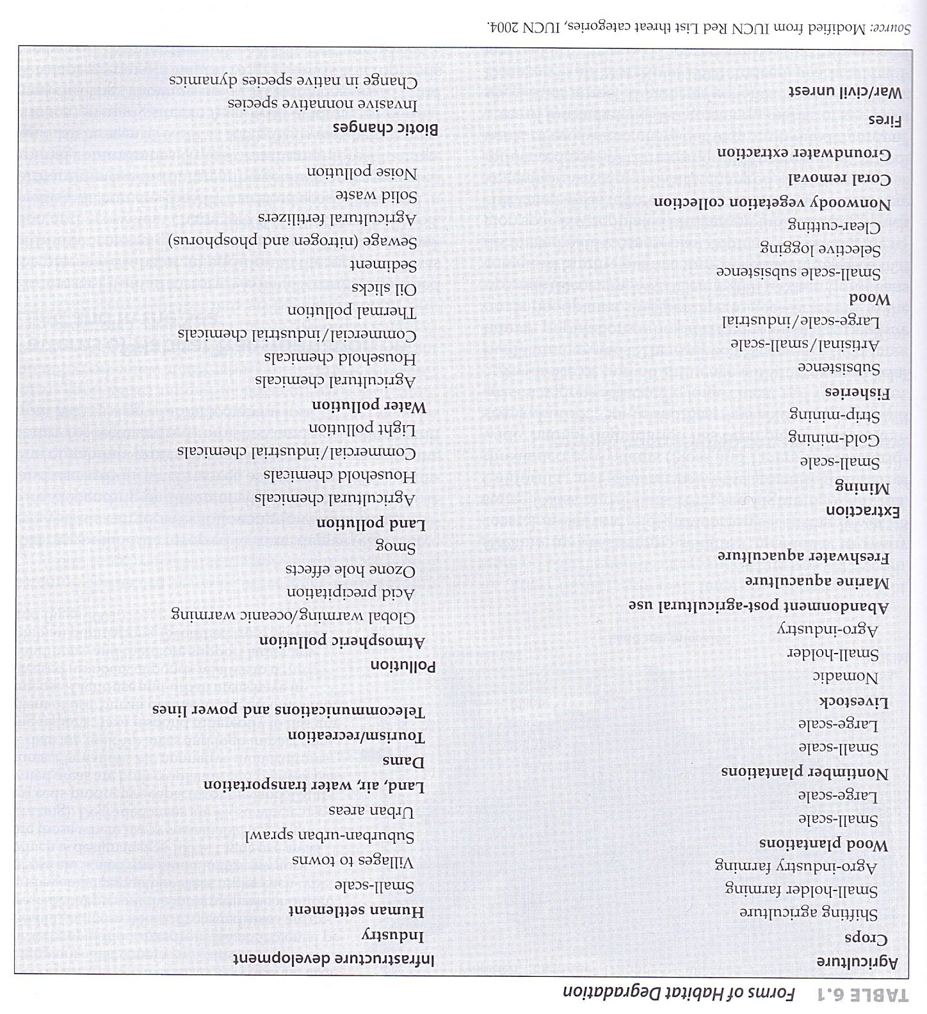
GROOM, M. J., MEFFE, G. K. and CARROLL, C. R. 2005. Principles of Conservation Biology. Sinauer Associate. Page 175.

